Slide 1

WEYLAND ENERGY
Harrow Bay Steering Committee
Meeting No. 9 · 23 September 2026 · Hamburg

Slide 2
Status at a glance
13 / 40
0
790
31.4
Monopiles installed (HB-A14 pitched)
Lost time injuries
EUR m spent of 1,620 m budget
EUR m contingency remaining
• Offshore substation topside installed on 19 August
• Export cable 2 delay (HB-RISK-017) remains the top risk
WEYLAND ENERGY · Harrow Bay Steering Committee – September 2026
2

Slide 3
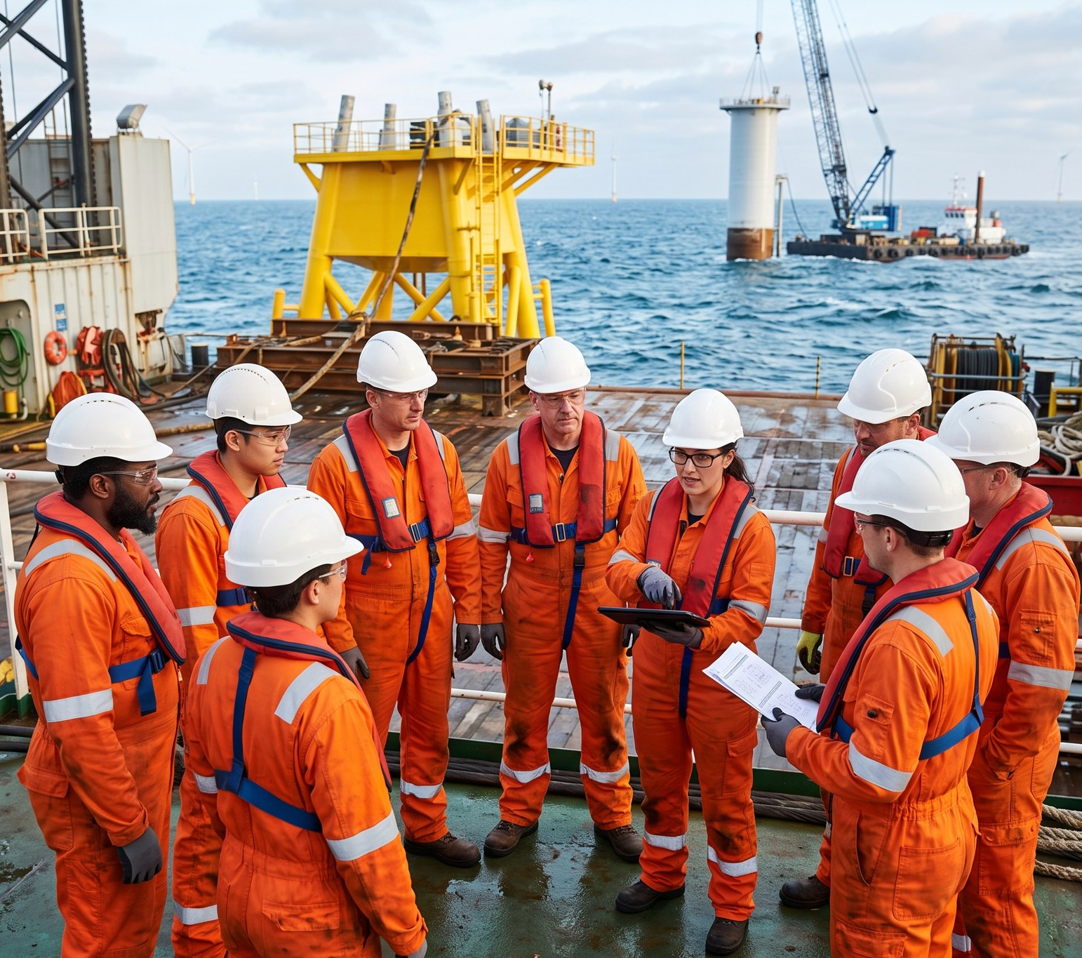
Safety
• 412,000 man-hours without lost time injury
• HSE-INC-2026-018 – all 8 corrective actions closed
• One medical treatment case (8 July, in port)
• 24/7 piling needs a fatigue management plan before start
WEYLAND ENERGY · Harrow Bay Steering Committee – September 2026
3
Notes:
Hannah to cover the fatigue point – she wants a hard stop if the plan is not in place by 3 Oct.

Slide 4
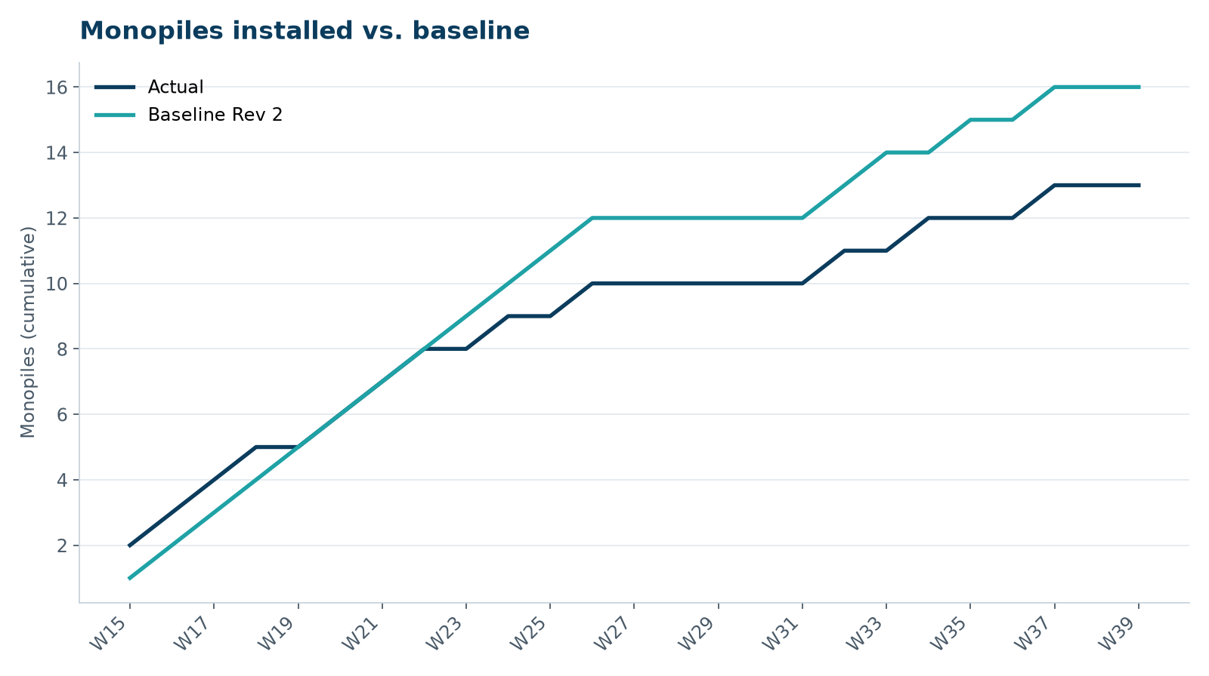
Foundations – progress vs. baseline
• 13 installed vs. 16 planned (-3)
• 210 h waiting on weather in September (to 27 Sep)
• HB-A14 pitched 26 Sep, driving pending
WEYLAND ENERGY · Harrow Bay Steering Committee – September 2026
4

Slide 5
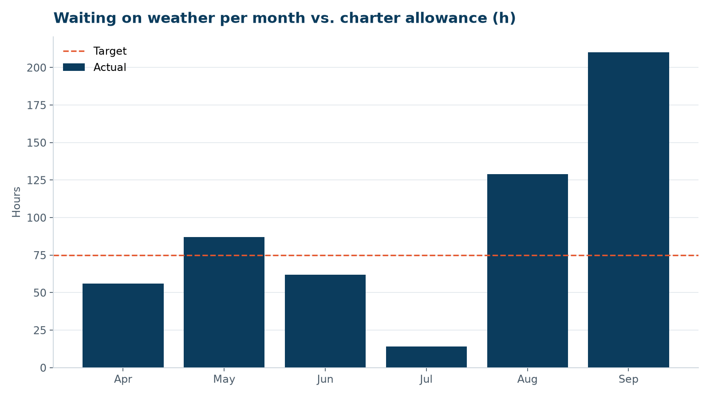
Weather downtime
• August and September far above the 75 h monthly allowance
• CO-009 standby EUR 2.33 m approved
WEYLAND ENERGY · Harrow Bay Steering Committee – September 2026
5

Slide 6
Monopile recovery plan – for decision
• Exercise charter option 2: +45 days, EUR 2.25 m (CO-011)
• 24/7 piling outside night-time restriction areas
• Four piles per load-out for string B
• Forecast last monopile 26 Feb 2027 (baseline 12 Feb)
• No impact on first turbine installation 1 Mar 2027
WEYLAND ENERGY · Harrow Bay Steering Committee – September 2026
6
Notes:
Ask: approve D-015 and D-016 today so Atlas Marine can confirm crew for option period.

Slide 7
Export cable 2 – HB-RISK-017
Severn Subsea Cables factory test failure, 21 July 2026

Slide 8
Cable delay – where we stand
Item | Status
Root cause | Partial discharge in factory joint FJ-2/07
Scope | Re-manufacture of 9 km section
Delivery | 15 Jan 2027 → 12 Mar 2027 (+8 weeks)
Mitigation | Resequenced lay (D-013), first power via export cable 1
Commercial | CO-010 EUR 6.8 m vs. LDs EUR 85k/day after 21-day grace
Next step | CEO-level meeting if not agreed by 15 Oct
WEYLAND ENERGY · Harrow Bay Steering Committee – September 2026
8

Slide 9
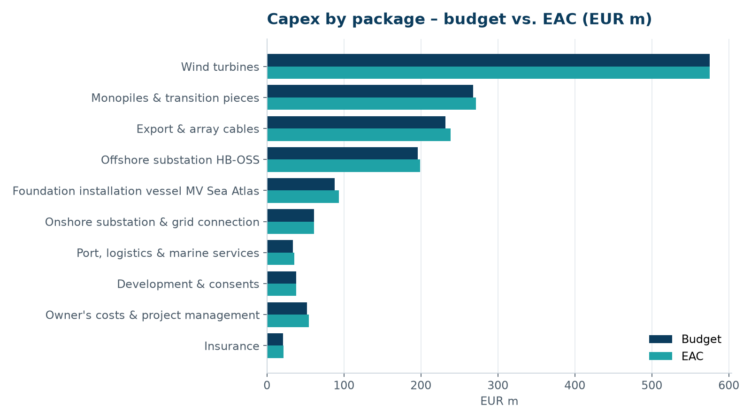
Cost
• EAC EUR 1,620 m – on budget
• Contingency drawn EUR 23.6 m of 55.0 m
• LD recovery EUR 4.2 m not yet included
WEYLAND ENERGY · Harrow Bay Steering Committee – September 2026
9

Slide 10
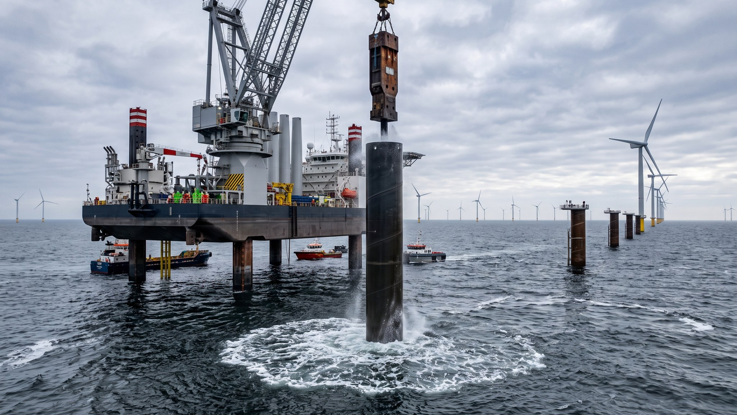
WEYLAND ENERGY
Thank you
Next SteerCo: 21 October 2026

